Slide 1
Chapter 10
Transactions

Slide 2
ACID Test
Atomicity
All operations of a transaction must be completed
If not, the transaction is aborted
Consistency
Permanence of database’s consistent state
Isolation
Data used during transaction cannot be used by second transaction until the first is completed
Durability
Ensures that once transactions are committed, they cannot be undone or lost

Slide 3
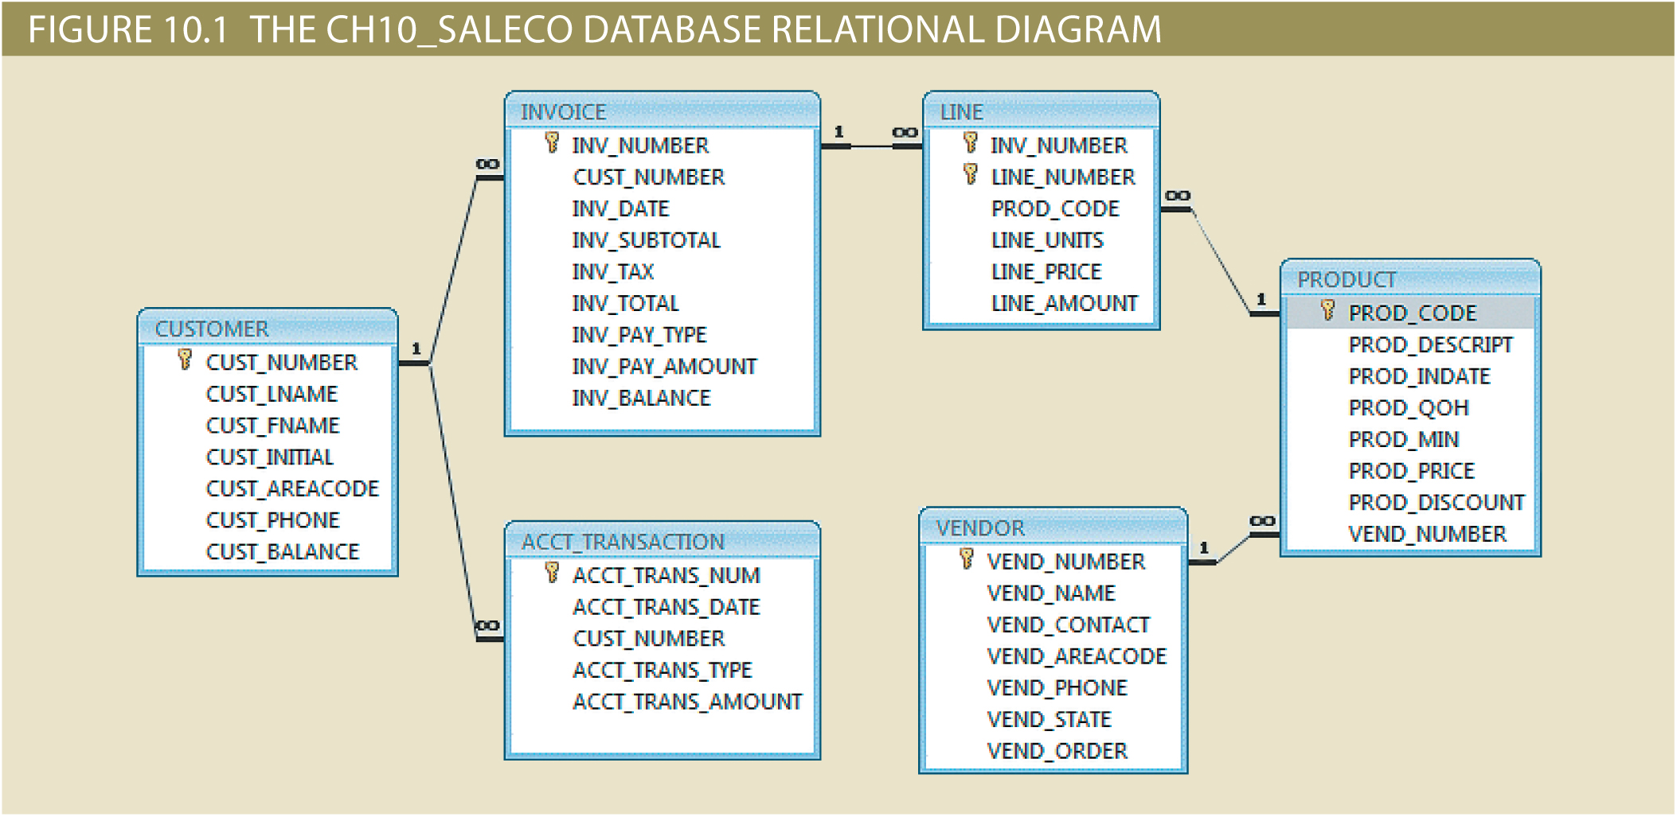

Slide 4
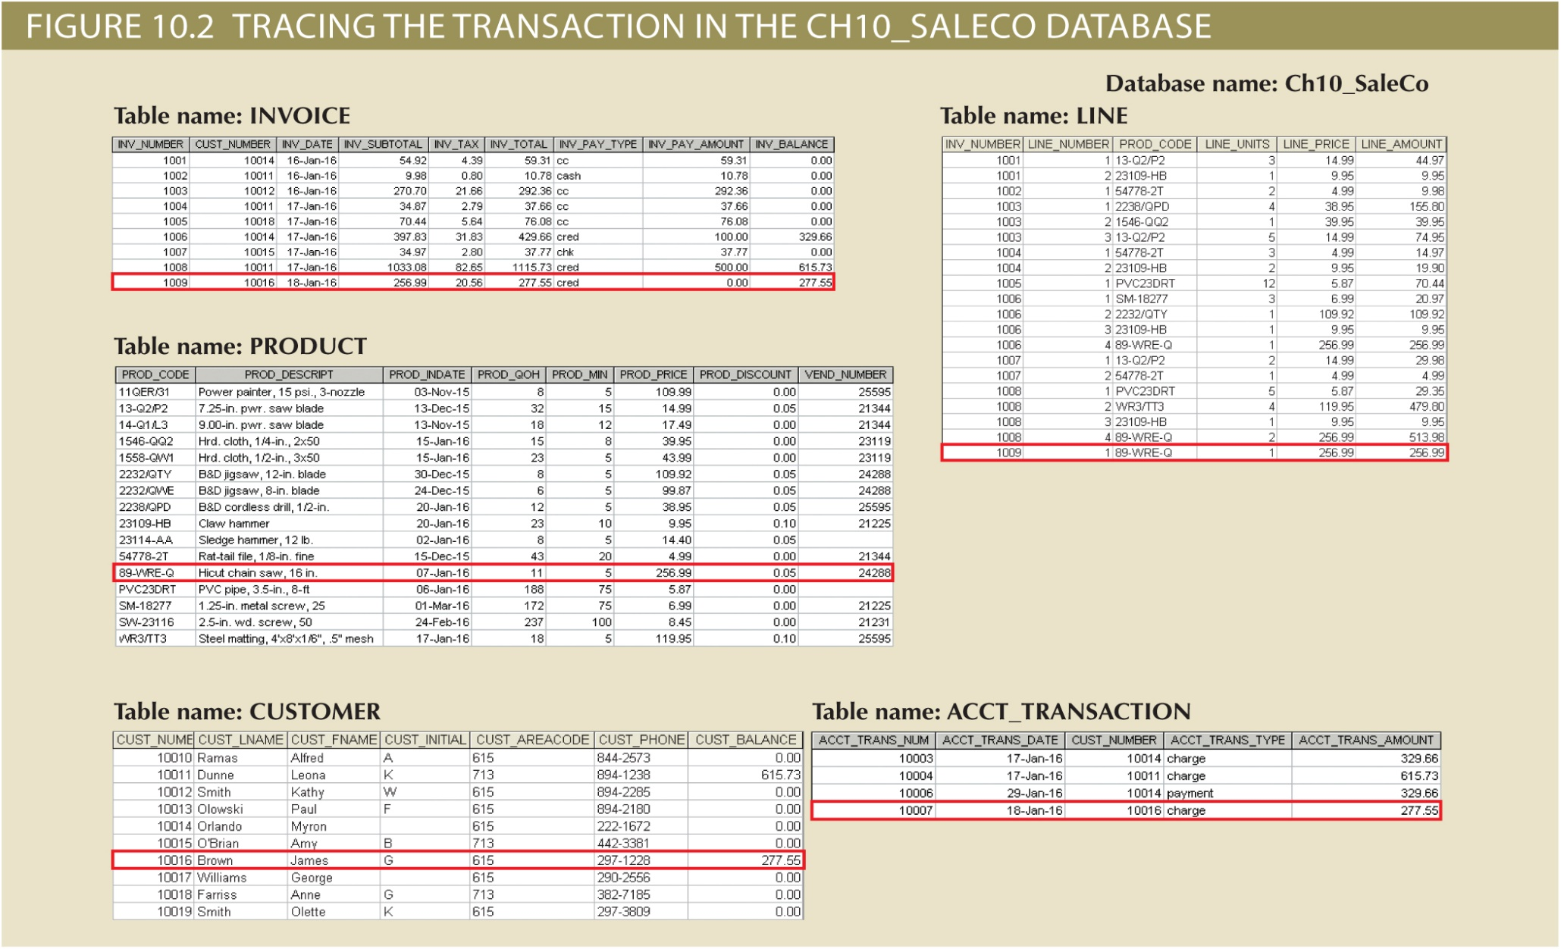

Slide 5
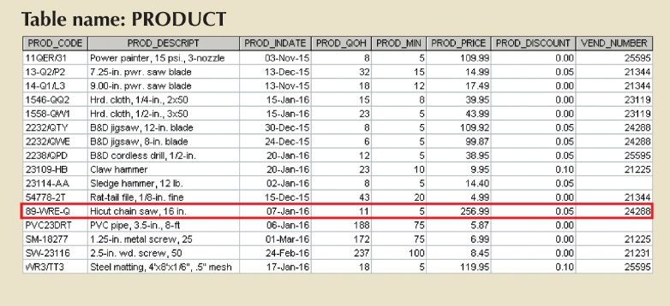
Customer 10016 purchase a chainsaw 89-WRE-Q for $256.99 + tax

Slide 6
Transaction
Transaction (Ch10_Transaction.sql):
SELECT * FROM CUSTOMER10 WHERE CUST_NUMBER = 10016;
START TRANSACTION;
INSERT INTO INVOICE VALUES(1009, 10016, '2016-01-18', 256.99, 20.56, 277.55, 'cred', 0.00, 277.55);
INSERT INTO LINE VALUES(1009, 1, '89-WRE-Q', 1, 256.99, 256.99);
UPDATE PRODUCT
SET PROD_QOH = PROD_QOH-1
WHERE PROD_CODE = '89-WRE-Q';
UPDATE CUSTOMER10
SET CUST_BALANCE = CUST_BALANCE + 277.55
WHERE CUST_NUMBER = 10016;
INSERT INTO ACCT_TRANSACTION VALUE(10007, '2016-01-18', 10016, 'charge', 277.55);
COMMIT;

Slide 7
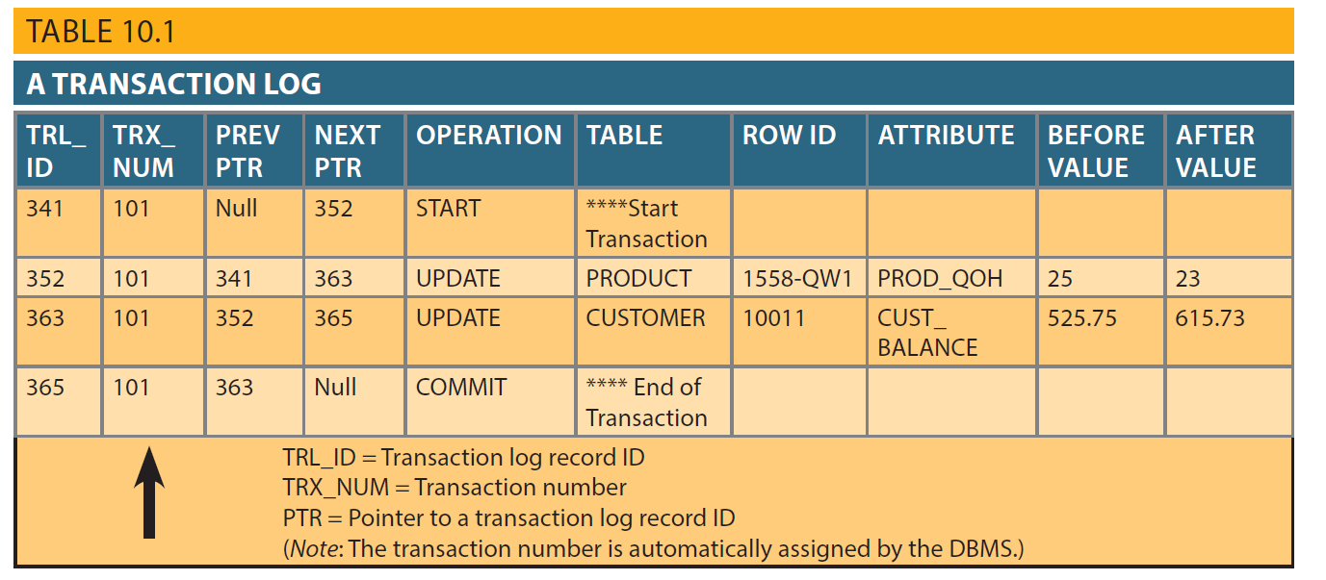
Transaction Log Customer 10011 purchases 2 cloths for $43.99/each

Slide 8
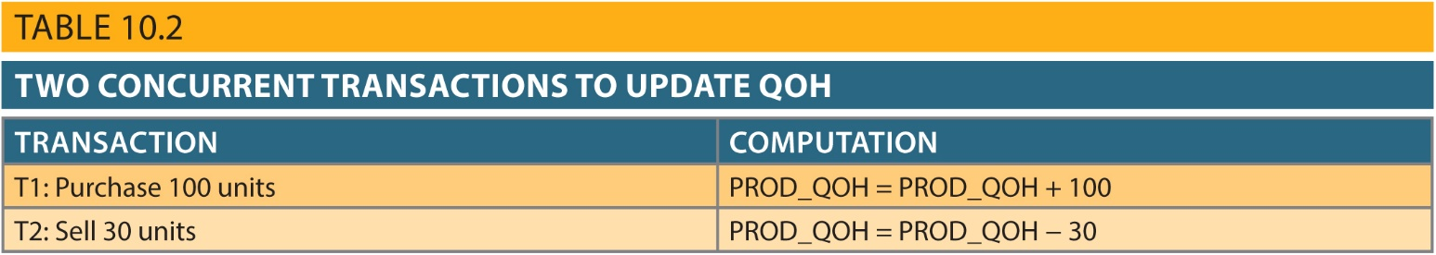

Slide 9
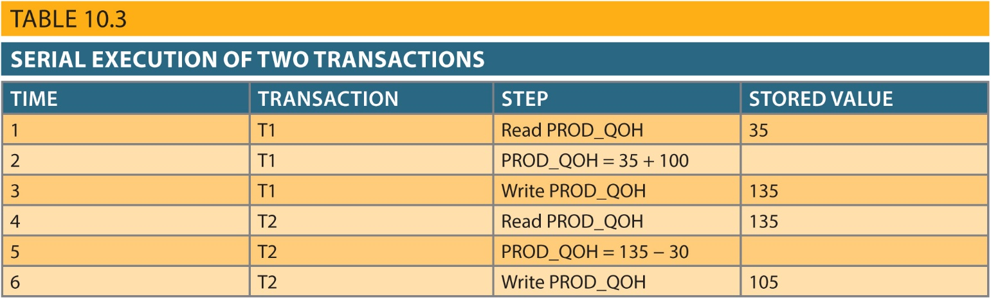
Correct Action

Slide 10
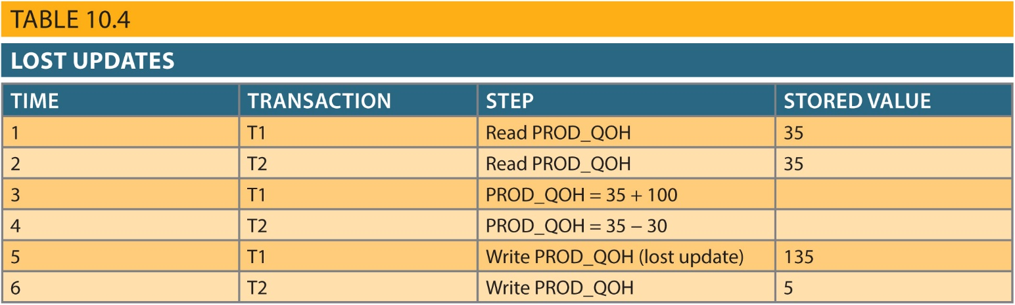
Lost Update

Slide 11
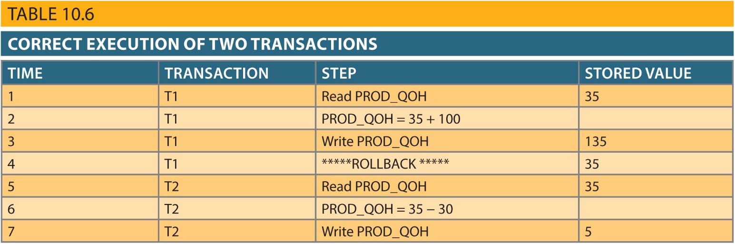
Correct Action when T1 Rollsback

Slide 12
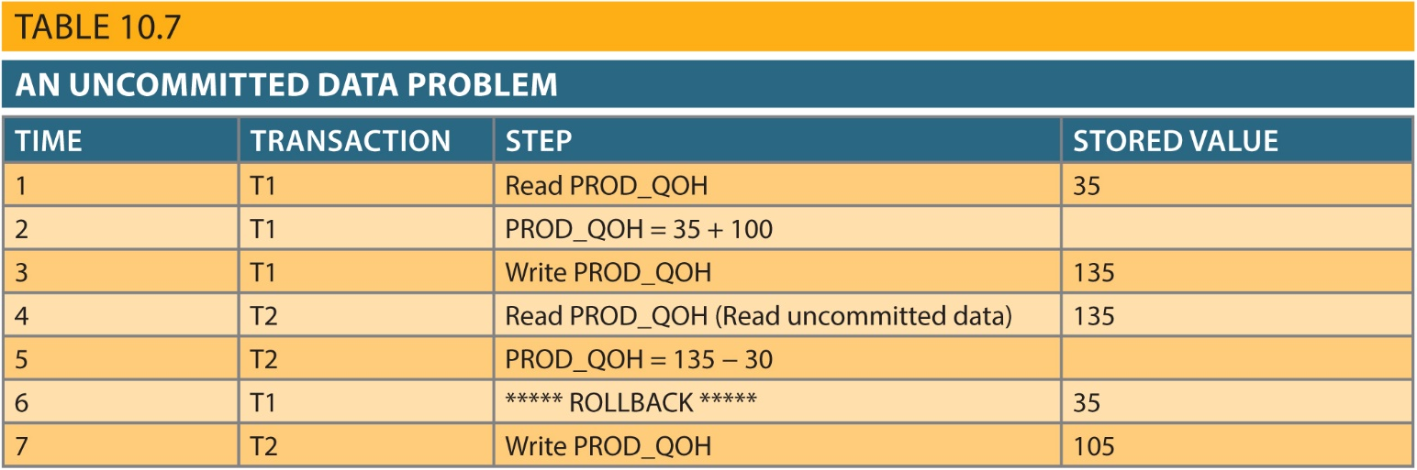
T2 Uses Data from a Dirty Read (Uncommitted Data) T1 does a Rollback but T2 Commits

Slide 13
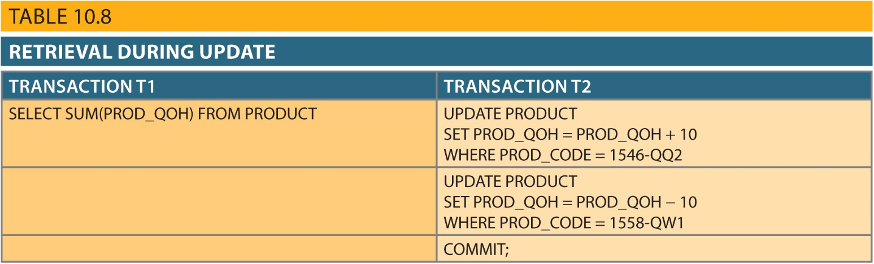
New Scenario for Concurrent Transactions T1 & T2

Slide 14
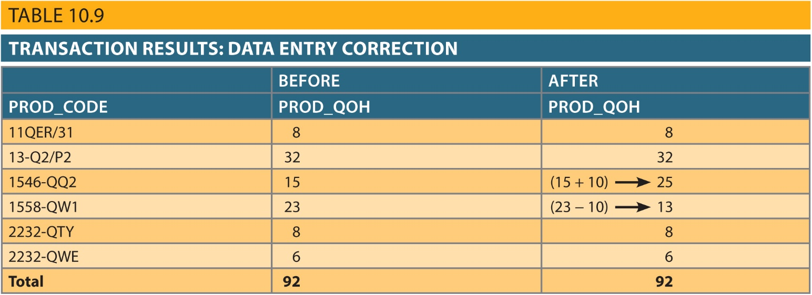
Correct Action – T1 Access Data After all of T2’s Updates

Slide 15
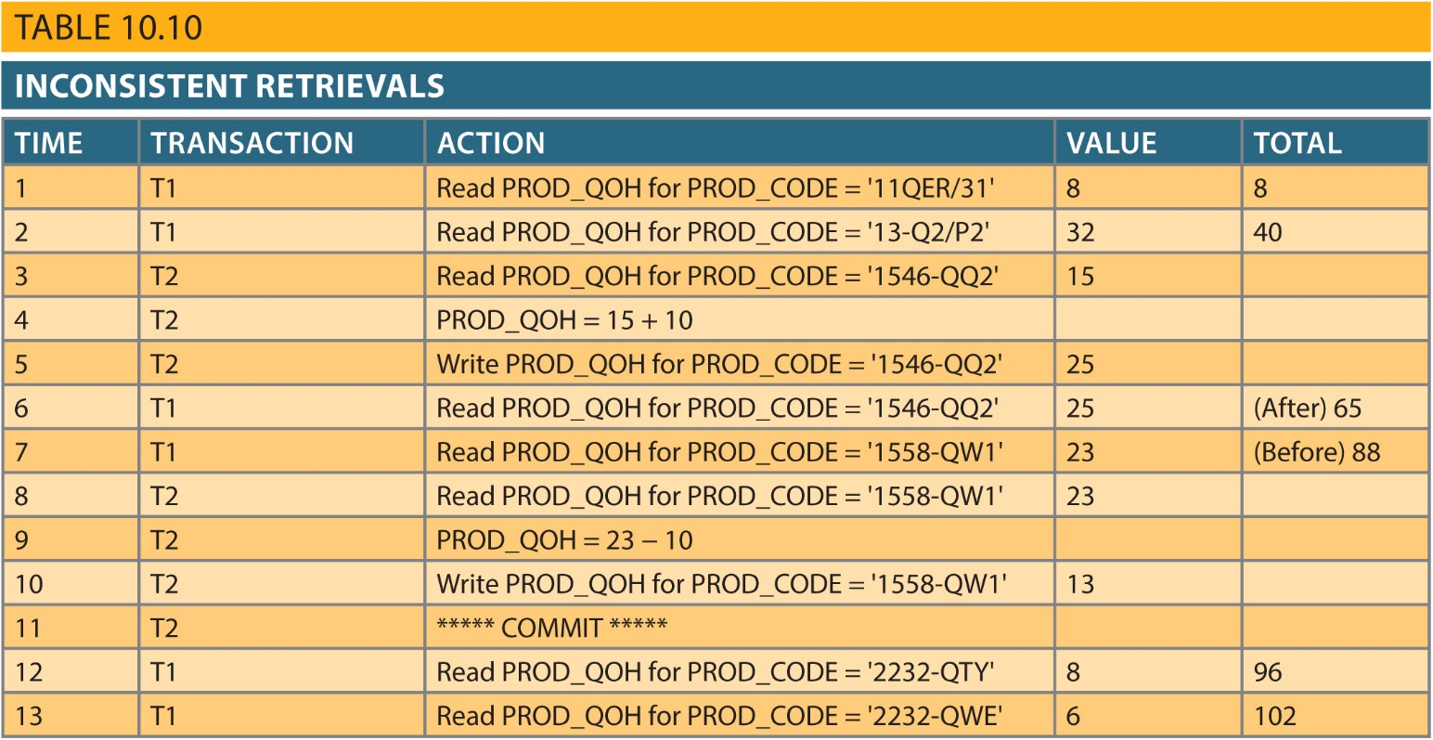
Inconsistent Retrieval – T1 Accesses Data AFTER T2 Updates – T1 Then Accesses Data BEFORE T2 Updates

Slide 16
Concurrency Control
Locking
Timestamp
Optimistic Methods

Slide 17
Binary Lock
TRANSACTION | STEP | STORED VALUE
T1 | Lock PRODUCT
T1 | Read PROD_QOH | 15
T1 | PROD_QOH = PROD_QOH + 10
T1 | Write PROD_QOH | 25
T1 | Unlock PRODUCT
T2 | Lock PRODUCT
T2 | Read PROD_QOH | 23
T2 | PROD_QOH = PROD_QOH - 10
T2 | Write PROD_QOH | 13
T2 | Unlock PRODUCT

Slide 18
Shared/Exclusive Lock
States
Unlocked
Shared (reading only)
Exclusive (updating, inserting)
Only allowed if a tables current state is Unlocked

Slide 19
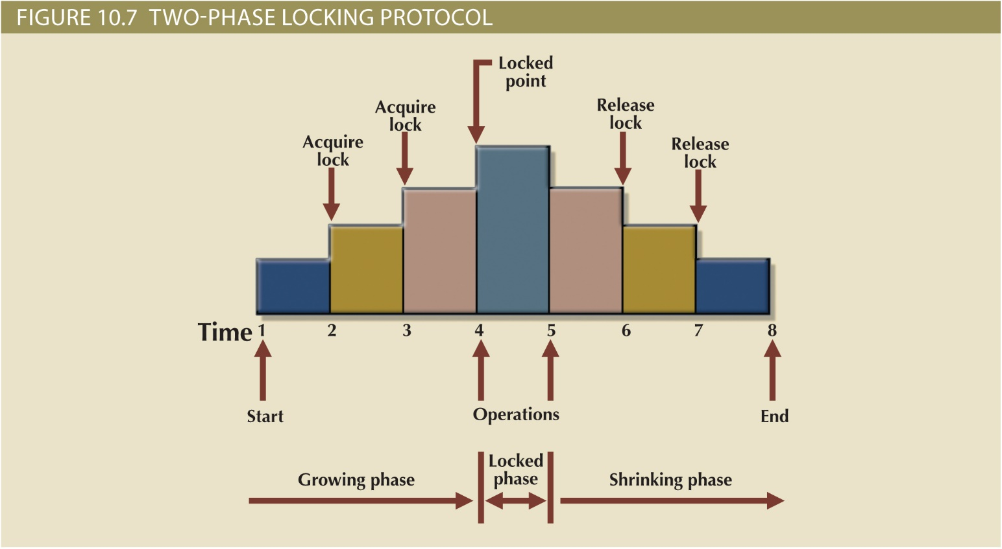
Two-Phase Lock

Slide 20
Locking Example (Handout #3)
BEGIN TRANSACTION
INSERT INTO INVOICE VALUES (10983, ‘10010’, ‘11-May-2016’, 118.80, ‘30’, ‘OPEN’ );
INSERT INTO LINE VALUES (10983, 1, ‘11QER/31’, 1, 110.00);
UPDATE PRODUCT SET P_QTYOH = P_QTYOH – 1 WHERE P_CODE = ‘11QER/31’;
UPDATE CUSTOMER
SET CUS_DATELSTPUR = ‘11-May-2016’, CUS_BALANCE = CUS_BALANCE +118.80
WHERE CUS_CODE = ‘10010’;
COMMIT;

Slide 21
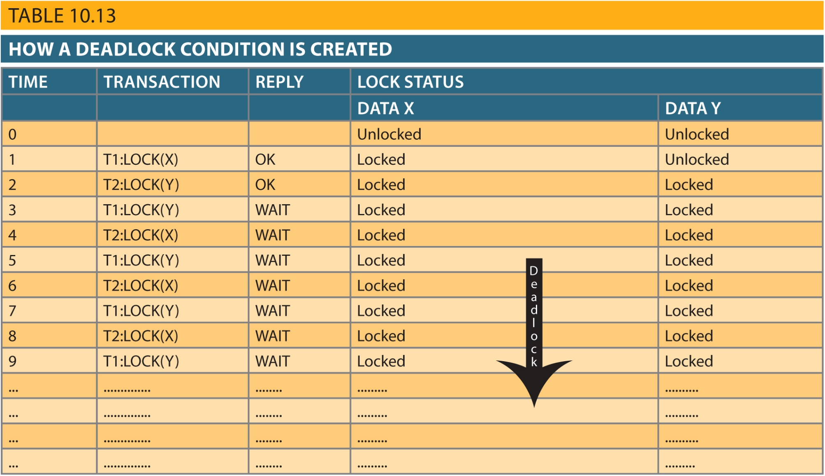
Deadlocking Transactions

Slide 22
Detecting Deadlocks
Deadlock Prevention
Deadlocks likely
Deadlock Detection
Deadlocks unlikely
Deadlock Avoidance

Slide 23
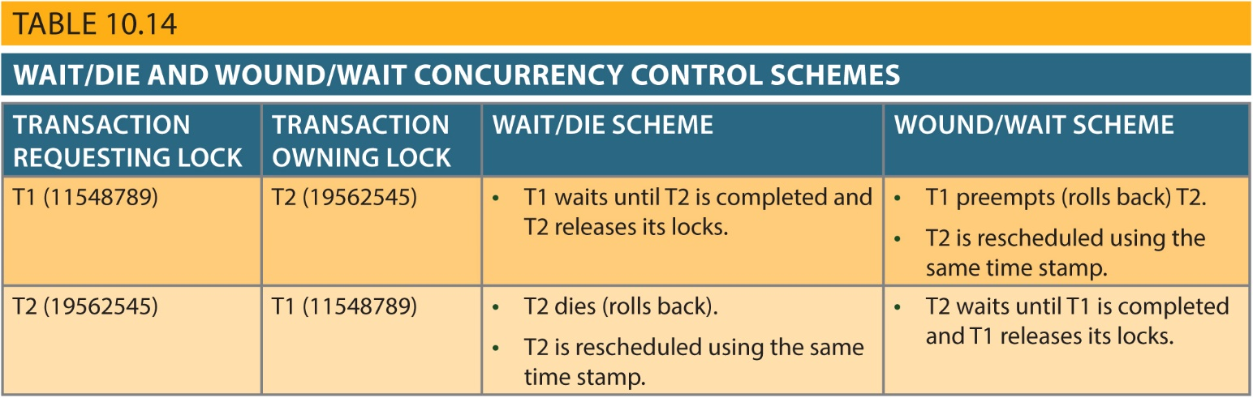
Timestamp

Slide 24
Optimistic Method
Read
Temporary file used to make updates
Validate
Determination of whether database is in a consistent state
Write
Permanent changes made to database ONLY if it is in a consistent state

Slide 25
Chapter 8
PL/SQL: Stored Procedures & Triggers

Slide 26
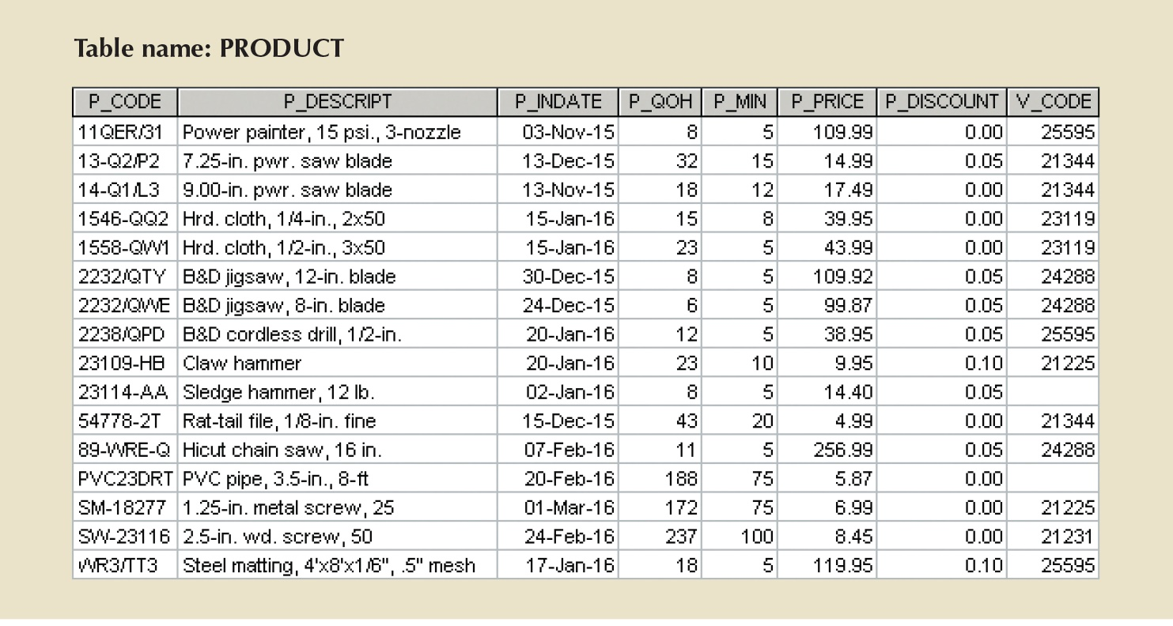
Procedural SQL – PRODUCT table

Slide 27
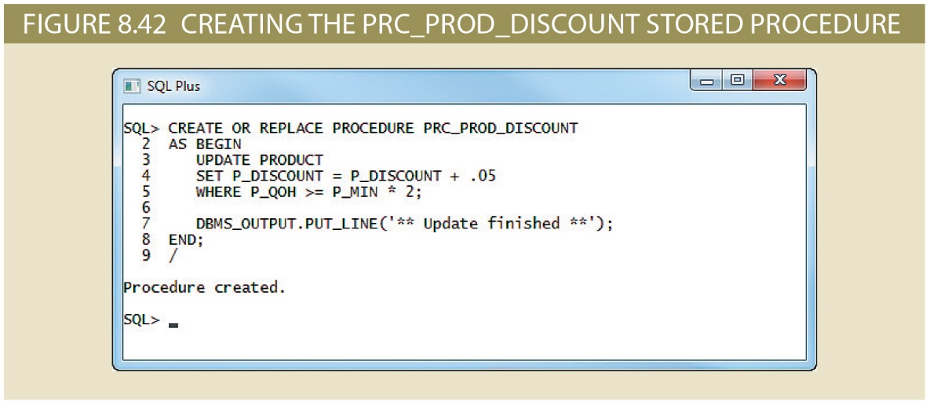
Stored Procedures
Apply a 5% discount for all products that have an inventory twice the minimum.
DBMS_OUTPUT.PUT_LINE is Oracle specific. In MySQL, use PRINT

Slide 28
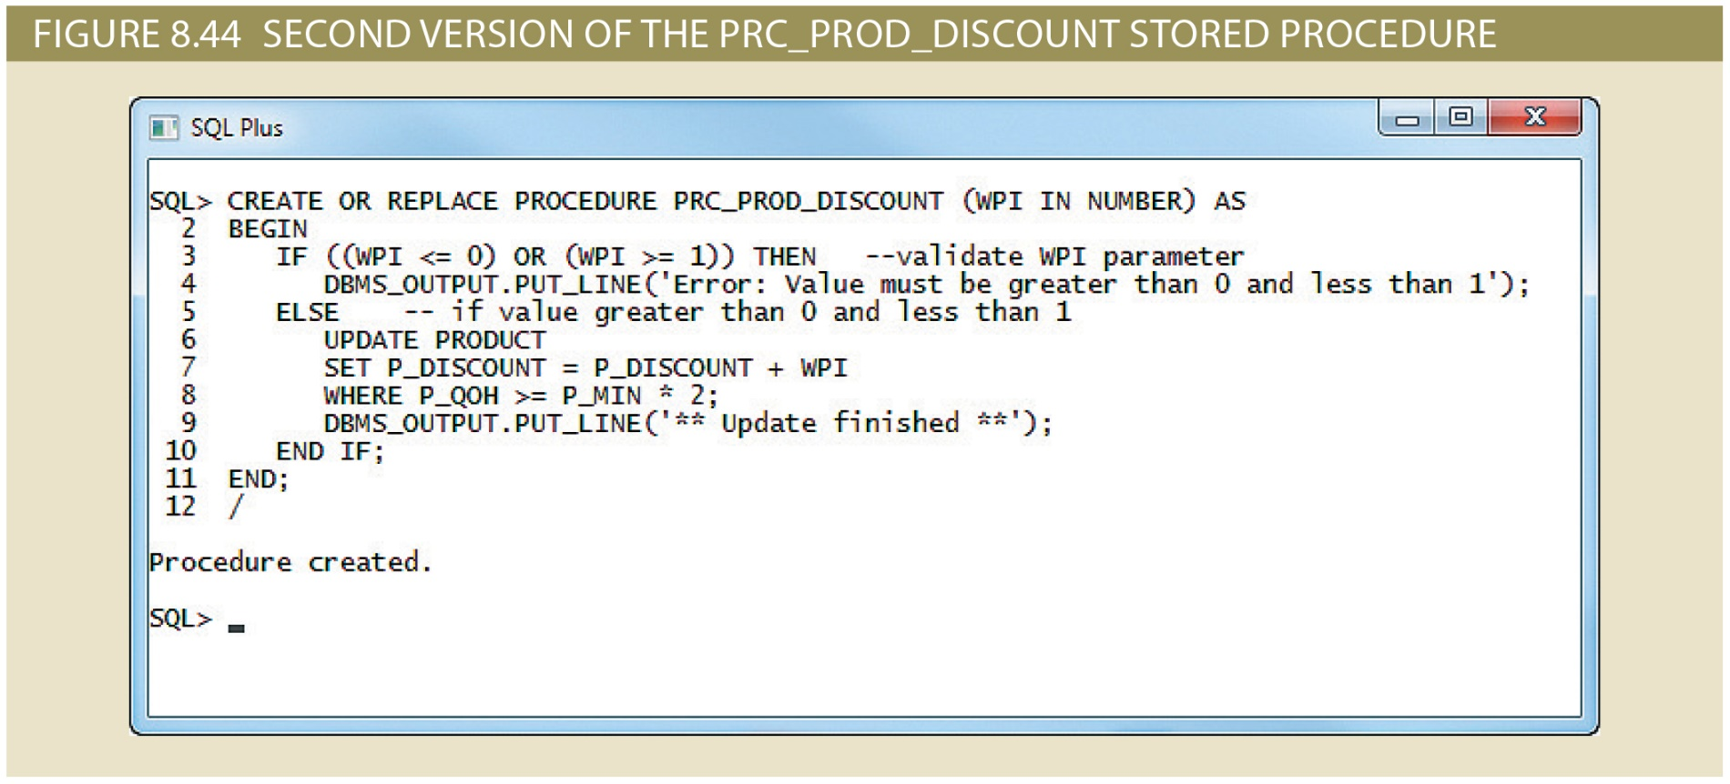
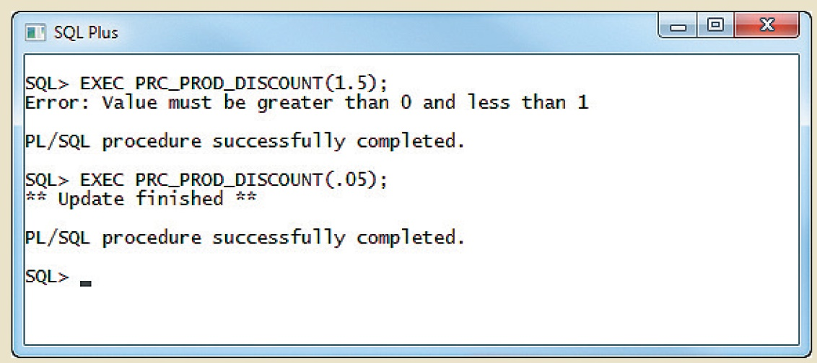
Stored Procedures – passing parameters
Call
Call

Slide 29
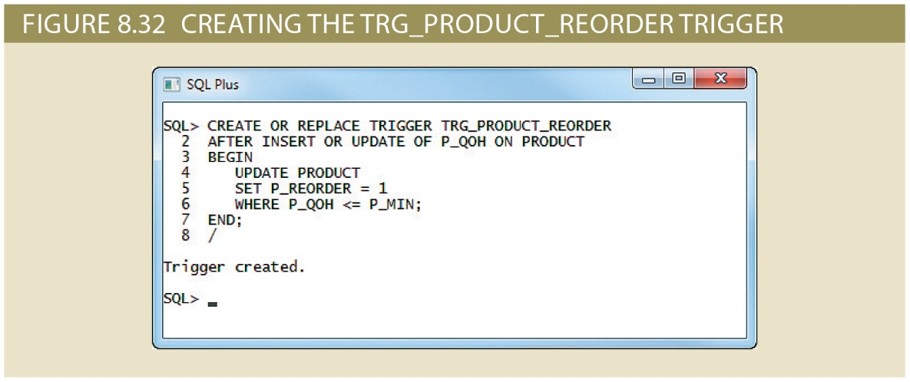
Triggers
Create a trigger to check quantity on hand (QOH) and reorder a product if inventory drops below minimum

Slide 30
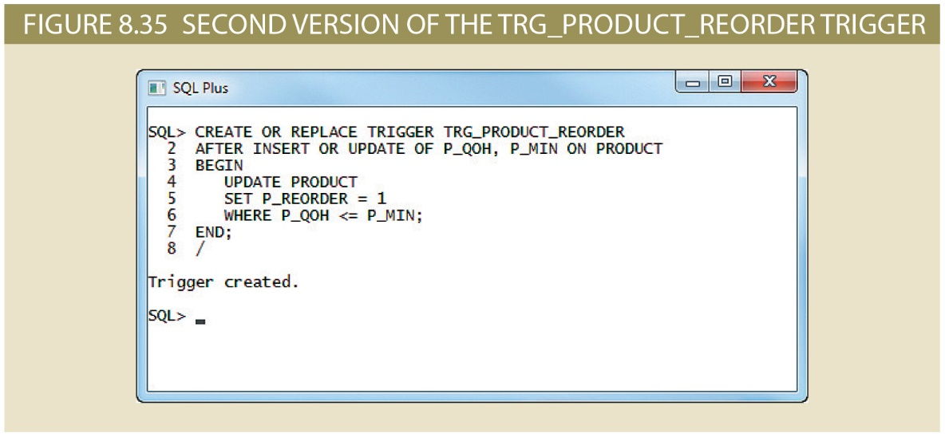
Triggers
Modify trigger to check for a change in quantity on hand or minimum amount in inventory

Slide 31
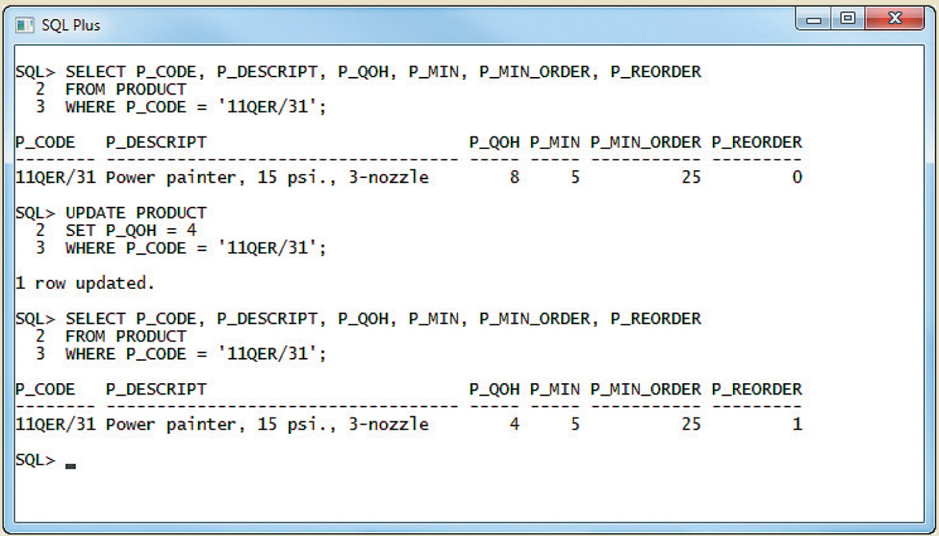
Triggers – changing P_QOH

Slide 32
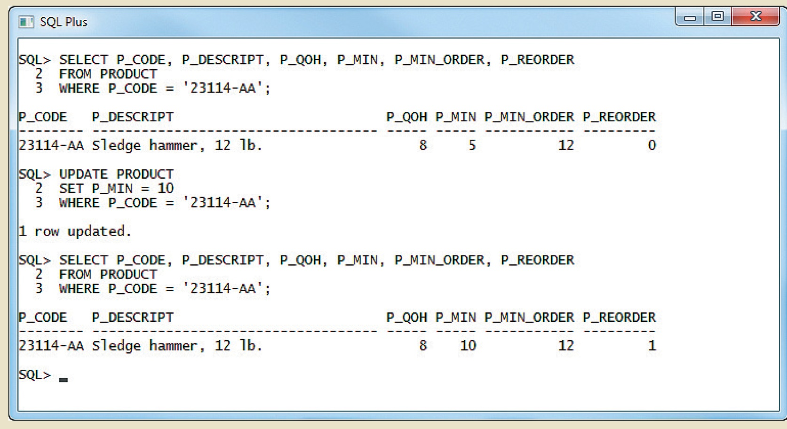
Triggers – changing P_MIN, instead

Slide 33
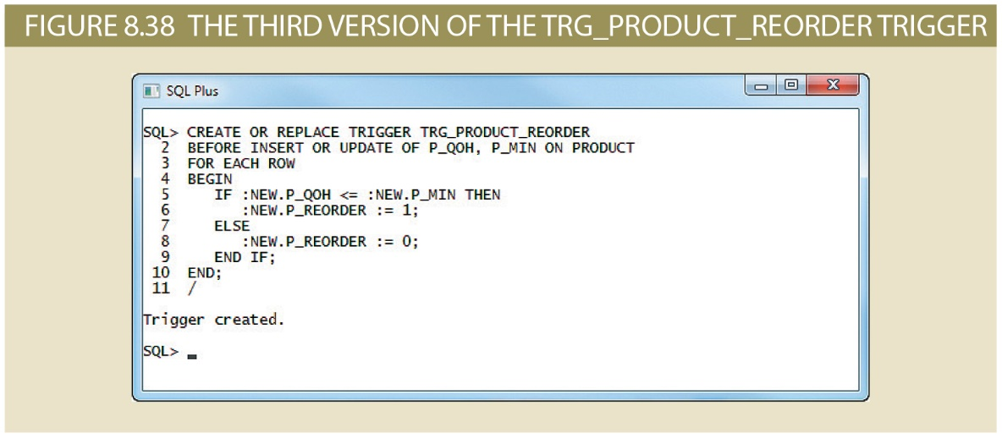
Triggers
NEW
NEW
NEW
NEW

